Slide 1
CS 470 Project Two Conference Presentation: Cloud Development
Victor Jarvis
February 2025

Slide 2
Overview
Who am I?
I’m Victor
Why are we here?
To discuss cloud development. (For both technical and nontechnical audiences.)

Slide 3
Containerization
Rehosting, Replatforming, Refactoring / Rearchitecting
Docker, Docker Compose

Slide 4
Orchestration
Let’s talk Docker Compose
Simplified Local Development
Iteration
Infrastructure
Testing
Consistent Environments

Slide 5
The Serverless Cloud
Serverless
What is “Serverless”?
Advantages of Going Serverless
Reduced Operational Overhead
Automatic Scaling
Faster Time-to-Market
What is S3 storage?
How does it compare to local storage?

Slide 6
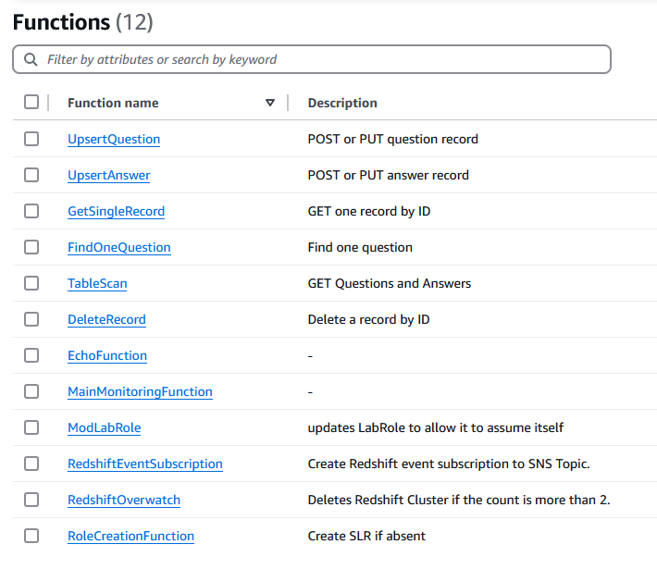
The Serverless Cloud
API & Lambda
Advantages a serverless API:
On-Demand Scaling
Cost Efficiency
Rapid Deployment
Lambda API Logic
Build & Deployment Scripts

Slide 7
The Serverless Cloud
API & Lambda
Integrating the frontend with the backend.
Use API Gateway to set endpoints
Create Lambda Functions to handle operations
Set CORS
Deploy and set stage for API
Point to the API URL in the application

Slide 8
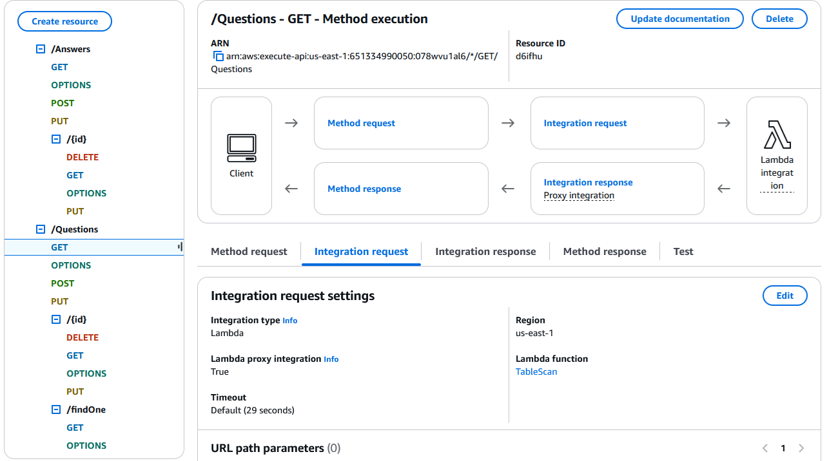
The Serverless Cloud
Database
Comparing MongoDB and DynamoDB
CRUD Queries:
GET
PUT
DELETE
POST
OPTIONS for CORS

Slide 9
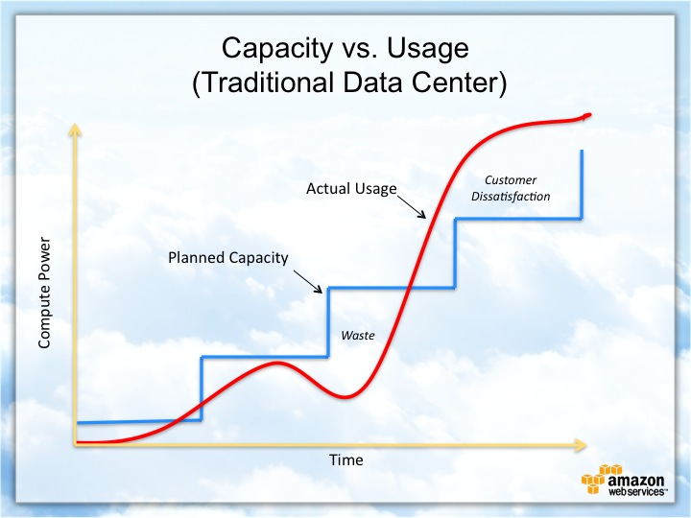
Cloud-Based Development Principles
Elasticity
Definition
Example
Why It Matters
Pay-For-Use
Definition
Example
Why It Matters

Slide 10
Securing Your Cloud App
Access
Policies
API Security
Authentication & Authorization
IAM Roles
Roles vs. Policies
Custom policies
Securing the connection between Lambda and Gateway
Lambda and the database
S3 Bucket

Slide 11
Conclusion
Efficiency
Choice
Security
Thank you for your time.

